Slide 1





MySQL and PHP Fundamentals
Table Relationships and Customization, Wildcards
MySQL & PHP
Advanced
SoftUni Team
Technical Trainers
Software University
http://softuni.bg

Slide 2
Questions
sli.do #PHP-WEB

Slide 3
Check List
Basic queries
SELECT
INSERT
UPDATE
DELETE
SQL + PHP
Error handling

Slide 4

Table of Contents
Table Relationships
Table Customization
Database optimisation
Wildcards

Slide 5
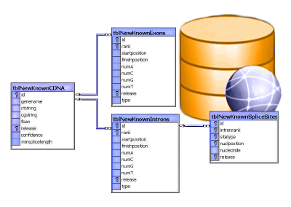
Table Relationships

Slide 6
Why Split Related Data?
Empty records
First | Last | Registered | Email
David | Rivers | 05/02/2016 | drivers@mail.cx
Sarah | Thorne | 07/17/2016 | sarah@mail.cx
Michael | Walters | 11/23/2015 | walters_michael@mail.cx
Email2
david@homedomain.cx
NULL
NULL
Redundant information
OrderID | Date | Customer | Product | S/N | Price
00315 | 07/16/2016 | David Rivers | Oil Pump | OP147-0623 | 69.90
00315 | 07/16/2016 | David Rivers | Accessory Belt | AB544-1648 | 149.99
00316 | 07/17/2016 | Sarah Thorne | Wiper Fluid | WF000-0001 | 99.90
00317 | 07/18/2016 | Michael Walters | Oil Pump | OP147-0623 | 69.90

Slide 7
Related Tables
We split the data and introduce relationships between the tables to avoid repeating information
The connection is established via a Foreign Key in one table pointing to the Primary Key in another
UserID | First | Last | Registered
203 | David | Rivers | 05/02/2016
204 | Sarah | Thorne | 07/17/2016
205 | Michael | Walters | 11/23/2015
UserID | Email
203 | drivers@mail.cx
204 | sarah@mail.cx
205 | walters_michael@mail.cx
203 | david@homedomain.cx
Primary Key
Foreign Key

Slide 8
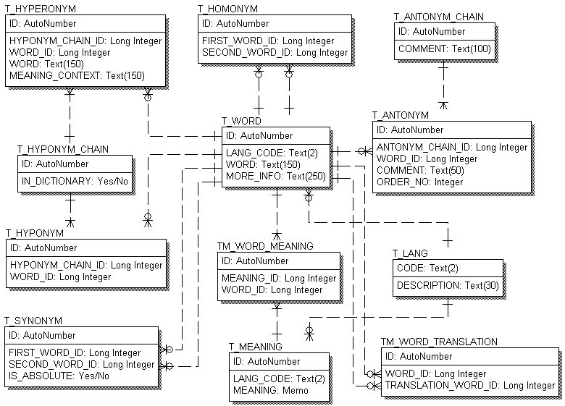
E/R Diagrams

Slide 9
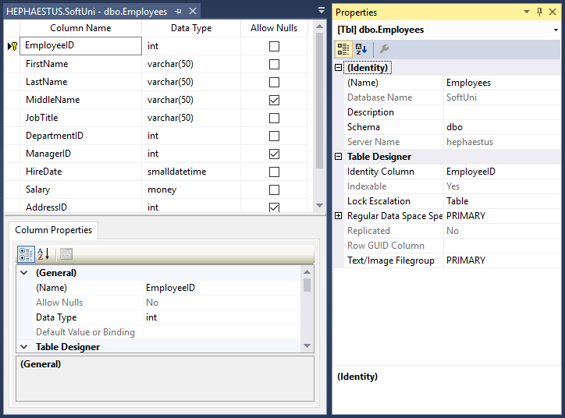
Altering Tables
Changing Table Properties After Creation

Slide 10
Altering Tables Using SQL
A table can be changed using the keywords ALTER TABLE
Add new column
ALTER TABLE Employees
Table name
ALTER TABLE Employees
ADD Salary INT
Column name
Data type

Slide 11
Altering Tables Using SQL (2)
Delete existing column
Modify data type of existing column
Column name
ALTER TABLE People
DROP COLUMN FullName
ALTER TABLE People CHANGE Email Email varchar(100)
Old column name
New column name
New data type

Slide 12
Altering Tables Using SQL (3)
Add primary key to existing column
Add unique constraint
Constraint name
ALTER TABLE People ADD CONSTRAINT PK_Id
PRIMARY KEY (Id)
Column name
(more than one for composite key)
Constraint name
ALTER TABLE People ADD CONSTRAINT uq_Email
UNIQUE (Email)
Columns name(s)

Slide 13
Altering Tables Using SQL (4)
To remove a constraining rule from a column
This includes primary keys, value constraints and unique fields
To remove default value
Table name
ALTER TABLE Employess DROP CONSTRAINT pk_Id
Constraint name
Table name
ALTER TABLE Employess ALTER Clients
DROP DEFAULT
Columns name

Slide 14
Altering Tables Using SQL (5)
Add foreign key to existing tables
Constraint name
ALTER TABLE Employees
ADD CONSTRAINT fk_employees_departments
FOREIGN KEY (department_id)
REFERENCES Departments (department_id)
ON DELETE CASCADE ON UPDATE CASCADE
PRIMARY KEY in the reference table
Propagate changes to foreign table

Slide 15
Programmability
Begin
?
?
Customizing Database Behavior

Slide 16
Indices
Indices make data lookup faster
Clustered – bound to the primary key, physically sorts data
Non-Clustered – can be any field, references the clustered index
Structured as an ordered tree
Keys
Index
0-99
100-199
200-299
Range 1
Range 2
Range 3
Data
Links
☰
☰
☰
☰
☰
☰
☰
☰
☰
☰
☰
☰
☰
☰

Slide 17
Views
Views are prepared queries for displaying sections of our data
Evaluated at run time – they do not increase performance
CREATE VIEW v_EmployeeNames AS
SELECT `EmployeeID`
,`FirstName`
,`LastName`
FROM `Employees`
SELECT * FROM v_EmployeeNames
Notes:
Views are objects that show portion of the data. For example, we may show only 3 column even though the table has 9.

Slide 18
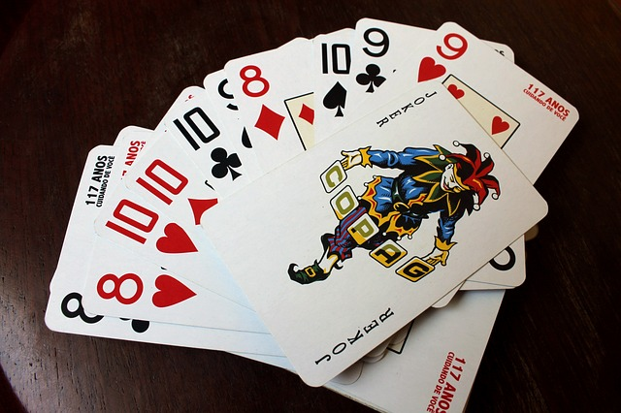
Wildcards
Selecting results by partial match

Slide 19
Using WHERE … LIKE
Wildcards are used with WHERE to filter for partial match
Similar to Regular Expressions
Example: Find all employees who's first name starts with "Ro"
SELECT ID, FirstName, LastName
FROM Employees
WHERE FirstName LIKE 'Ro%'
Wildcard symbol

Slide 20
Wildcard Characters
Supported characters include
ESCAPE – specify another escape character, the default is "\"
% --any string, including zero-length
_ --any single character
[…] --any character within range
[^…] --any character not in the range
SELECT ID, Name
FROM Tracks
WHERE Name LIKE '%max!%' ESCAPE '!'

Slide 21

Summary
Table relations reduce repetition and complexity
Using Wildcards we can obtain results by partial string matches

Slide 22








MySQL and PHP Basics
https://softuni.bg/courses/php-basics/

Slide 23

License
This course (slides, examples, demos, videos, homework, etc.) is licensed under the "Creative Commons Attribution-NonCommercial-ShareAlike 4.0 International" license
Attribution: this work may contain portions from
"PHP Manual" by The PHP Group under CC-BY license
"PHP and MySQL Web Development" course by Telerik Academy under CC-BY-NC-SA license

Slide 24




Free Trainings @ Software University
Software University Foundation – softuni.org
Software University – High-Quality Education, Profession and Job for Software Developers
softuni.bg
Software University @ Facebook
facebook.com/SoftwareUniversity
Software University Forums
forum.softuni.bg

